Slide 1
OptiSync Therapy
Synchronizing Light, Improving Your Life
An AlzLife Technology
Notes:
BRAINSTORM:
AlzLife Light Frame

Slide 2
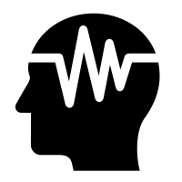
Value Proposition
For participants in Alzheimer’s clinical study, seeking to improve their cognition and sleep
Our solution is a light frame to provide 40Hz therapy to attach to any phone
Current 40Hz light therapy means require time set aside for the therapy: ours does not
Our product will meaningfully improve the therapy experience for patients of Alzheimer’s and dementia
Notes:
Note that sometimes you need more than one value proposition. For example if the beneficiary does not pay you, then you need one value proposition for your beneficiary and one for your paying customer.

Slide 3
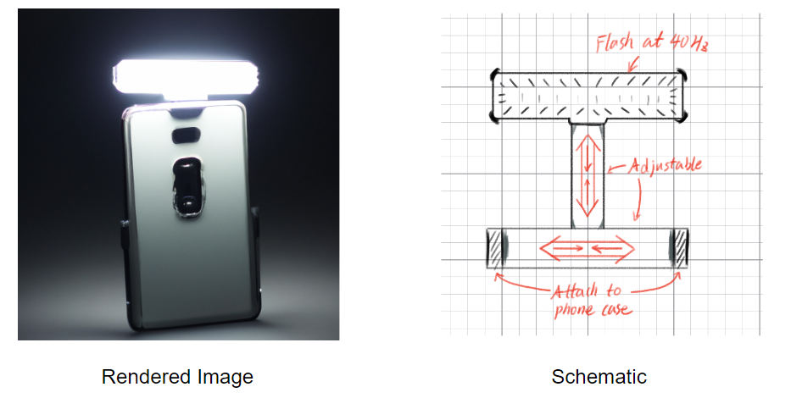
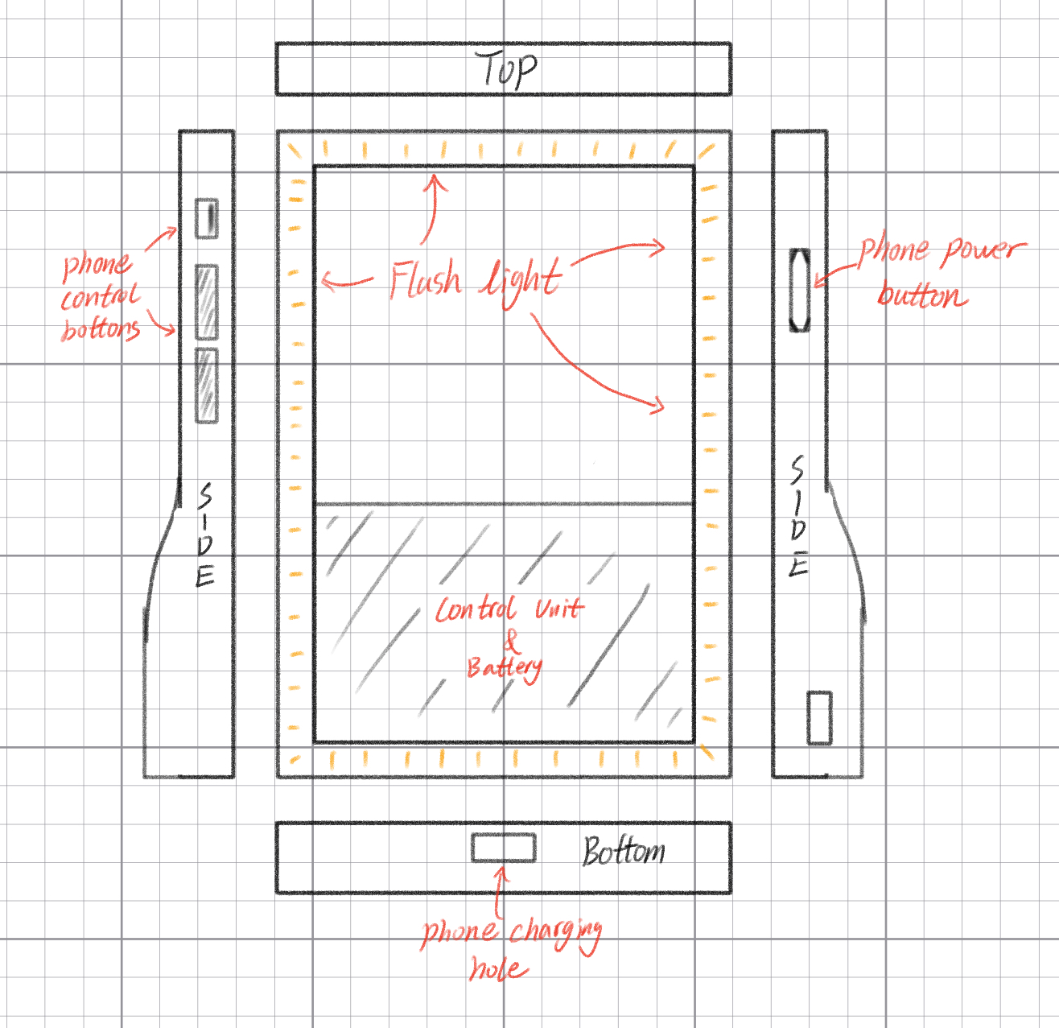
Possible implementation: a visualization

Slide 4

Minimum
Viable
Product
We need a light that flashes at 40 Hz at a consistent and comfortable intensity
It must attach to any phone case

Slide 5

Technology
Solution
Point 1: Advanced LED technology delivering consistent 40Hz frequency, maximizing therapeutic effects.
Point 2: Energy-efficient design ensuring extended use with minimal power consumption
Future step: Smart integration with an app allowing for tracking, reminders, and real-time feedback on therapy progress.

Slide 6
Thank you!

